Slide 1
jabbaScript
Weather App

Slide 2
Getting started
Getting familiar with fetching API
Planning our website (wireframe)
What data do we need exactly from the API and how can we fetch those
Lots of coffee!

Slide 3
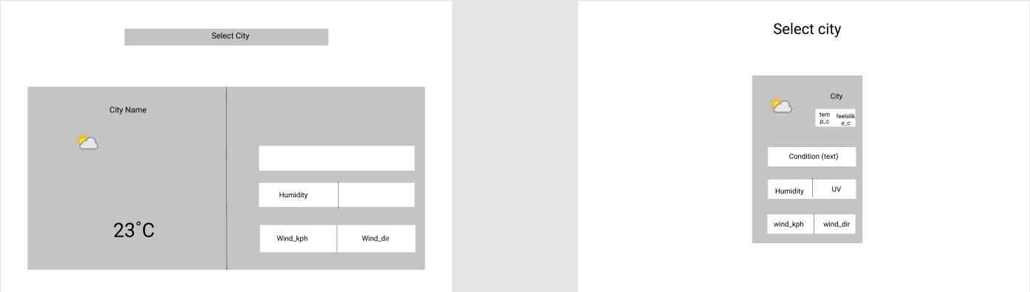
Wireframe
Two ideas to start with
Making sure, that if we don’t like the outcome, we can change it to the better

Slide 4
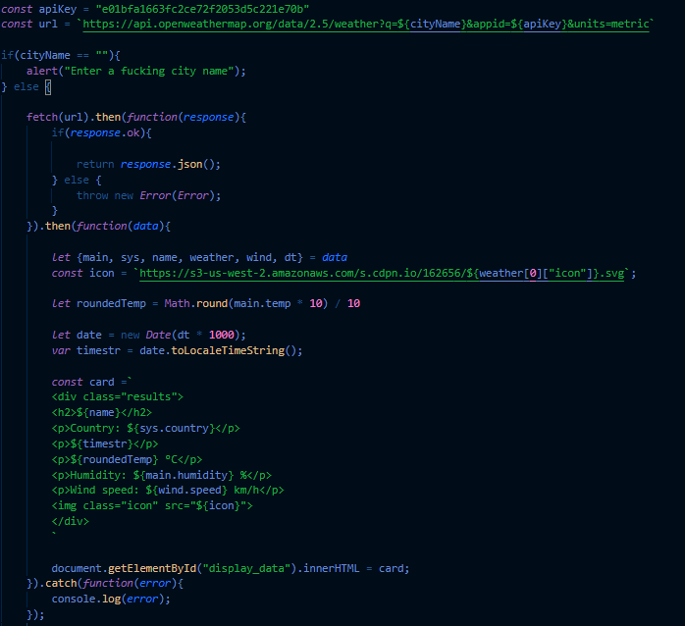
Problems with the API
No matter how hard we tried, we couldn’t fetch the data from weatherapi.com
We had to change our plans and fetch our data from www.openweather.org , but now it works like a charm!

Slide 5
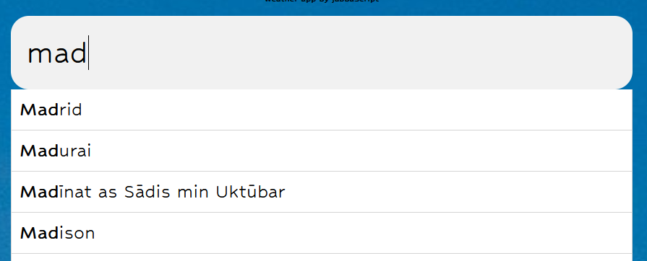
Autocomplete feature
We find the correct and useful code from w3schools.com
The autocomplete works after the third character
We put the list of cities in another js file as our database

Slide 6

Optional tasks
Spinner - our search results loaded too fast, so the spinner didn’t show up at all – we made some adjustments.
Change background with Pexels API – it does load a picture as background, but it has some issues.

Slide 7
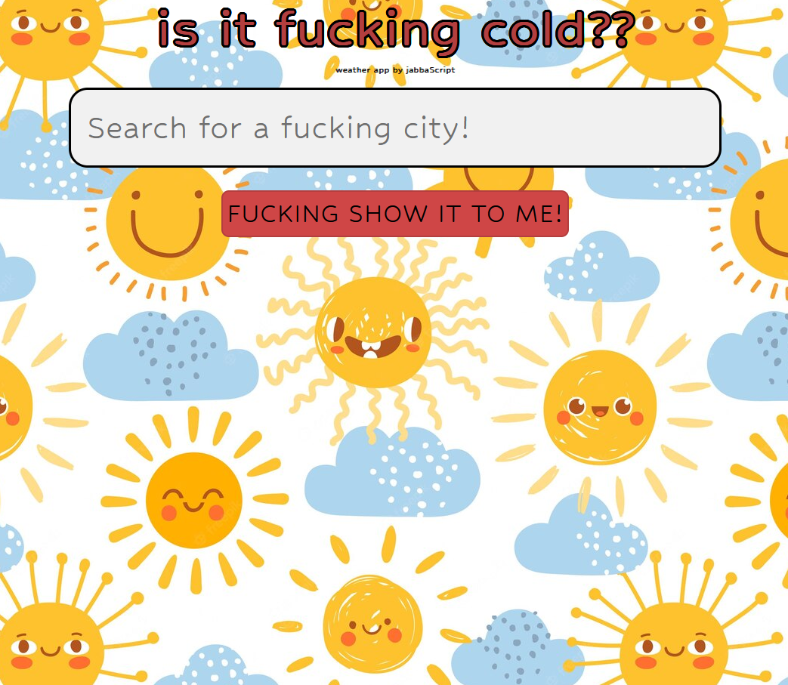
… and our site was born!

Slide 8
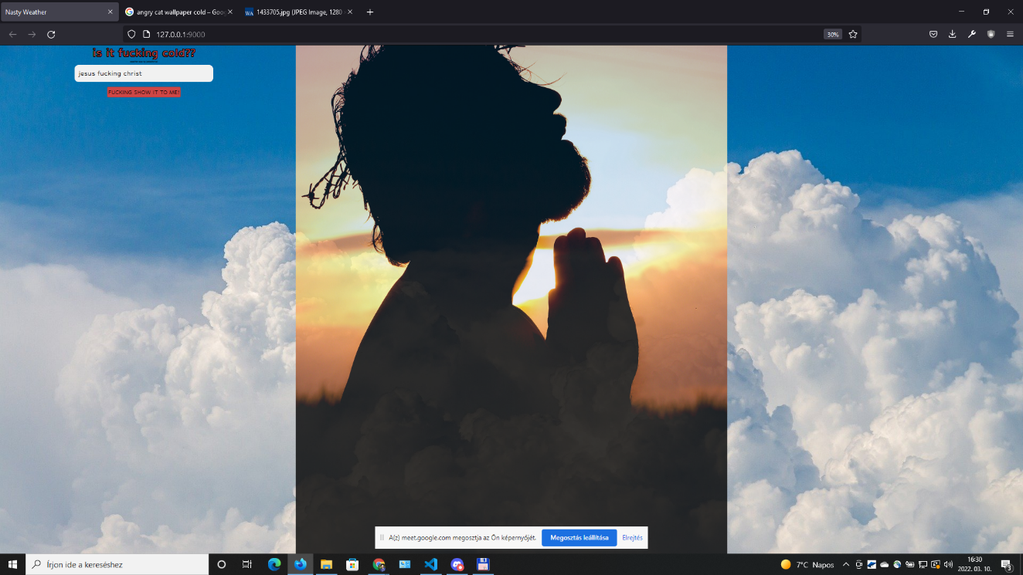
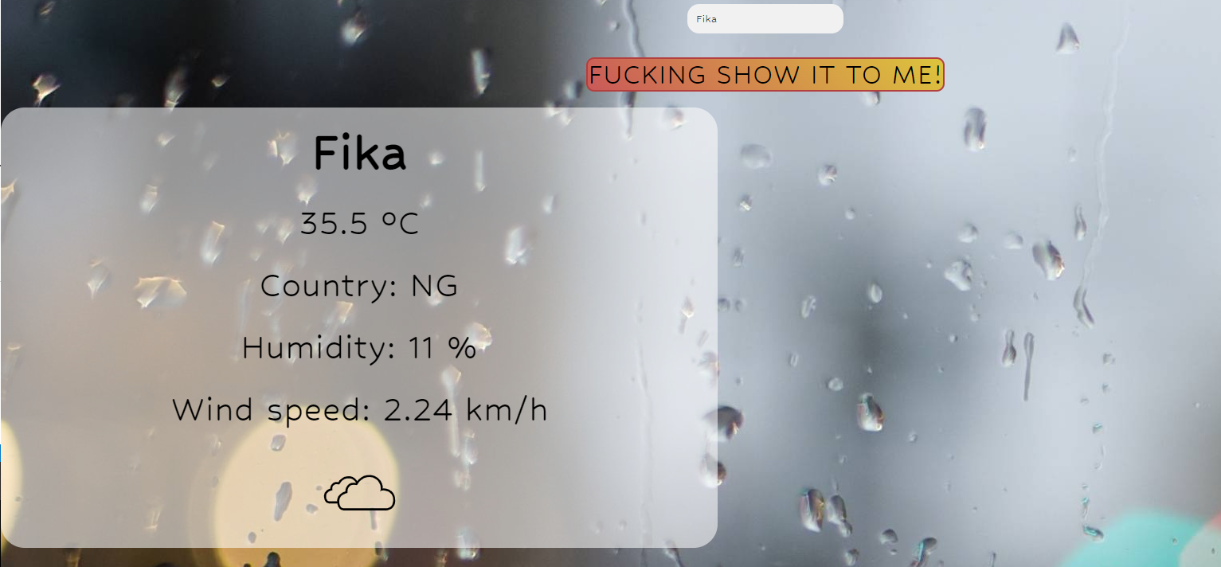
There were some „issues”….

